Slide 1
Fundamentals of Machine Learning Week 3: linear regression
Jonas Moons
All images are either own work, public domain, CC-licensed or fair use
Credits on last slide

Slide 2



Check-in

Slide 3
Feedback
Tip: use Seaborn instead of Pandas for graphs
Use Markdown for (plenty of) comments, including headers
Strive for academic language and correct English. Ask feedback!
Working together is encouraged to an extent, but avoid copying wholesale

Slide 4
Topics
Simple linear regression
Evaluation
Overfitting and model validation
Multiple linear regression

Slide 5
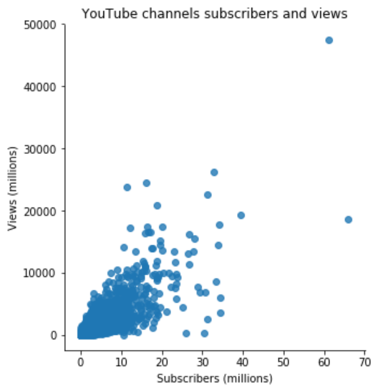
Linear relation
The points in the scatter plot seem to be centered around a line, with some variation
Variance in views seems to increase with subscribers

Slide 6
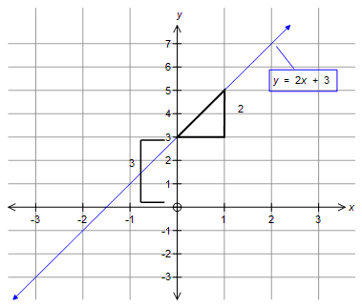
Linear relation

Slide 7
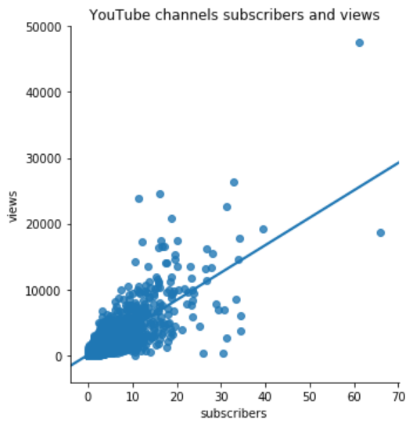

Linear regression formula
e ≈ 27,000M
$$Y=b_{0}{+ b}_{1}X+e$$
e ≈ -10,000M
Y = dependent variable: views
X = independent variable: subscribers
Coefficients (constant):
b₀ = intercept: how many views with no subscribers = 46
b₁ = slope: views per subscriber = 416.7
e = error / residual: what’s left over, what we can’t explain
The algorithm that finds the line minimizes the squared errors

Slide 8

Example data points
$$Y=b_{0}{+ b}_{1}X+e$$
Channel | X (subscribers) | Y (views) | b₀ | b₁ | Y’ (predicted views) | e (residual)
PewDiePie | 66M | 19000M | 46 | 416.7 | 28000M | -9000M
(Numbers are rounded down here and there to make it clearer)

Slide 9
Example data points
$$Y=b_{0}{+ b}_{1}X+e$$
Channel | X (subscribers) | Y (views) | b₀ | b₁ | Y’ (predicted views) | e (residual)
PewDiePie | 66M | 19000M | 46 | 416.7 | 28000M | -9000M
Taylor Swift | 28M | 16000M | 46 | 416.7 | 12000M | 4000M
(Numbers are rounded down here and there to make it clearer)

Slide 10
Example data points
$$Y=b_{0}{+ b}_{1}X+e$$
Channel | X (subscribers) | Y (views) | b₀ | b₁ | Y’ (predicted views) | e (residual)
PewDiePie | 66M | 19000M | 46 | 416.7 | 28000M | -9000M
Taylor Swift | 28M | 16000M | 46 | 416.7 | 12000M | 4000M
Eminem | 30M | 300M | 46 | 416.7 | 13000M | 12700M
(Numbers are rounded down here and there to make it clearer)

Slide 11
Exercise 1: linear regression
See the linear_regression Notebook in the Examples folder.
Using Seaborn, Pandas and sk-learn:
Import the Funda data set (or continue in the same Notebook as from last week)
Clean up the price variable. Make a scatter plot of price and surface area, both with and without a regression line. Which should be X and which should be Y?
Train a linear model for the relation using sk-learn. Write down the complete formula with X, Y and the coefficients b₀ and b₁ (as numbers). Use a Markdown cell and write the formula in pretty math notation.
Predict the price for a house of 70 m²
Use sk-learn to predict the price for all the houses in the dataset. What is the prediction for Slichtenhorststraat 10? What is the residual? Note: how to get this value is not in the example Notebook, but perhaps you can figure out how to retrieve it.

Slide 12
Topics
Simple linear regression
Evaluation
Overfitting and model validation
Multiple linear regression

Slide 13

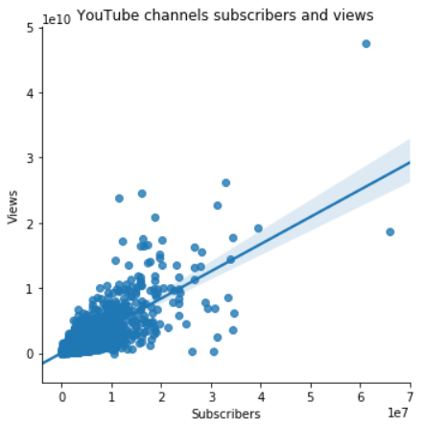

Assumptions of simple linear regression
Linearity (the points are around a straight line, not on a curved line)
Equal variance (the distance between the points and the line does not change very much)
Residuals are normally distributed (ignore this one for now)

Slide 14
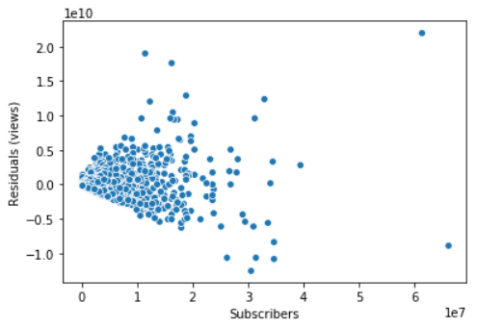
Inspect residuals/errors
Linear model
This means our predictions are poor for high numbers of subscribers!
Residuals (distance from the line)

Slide 15
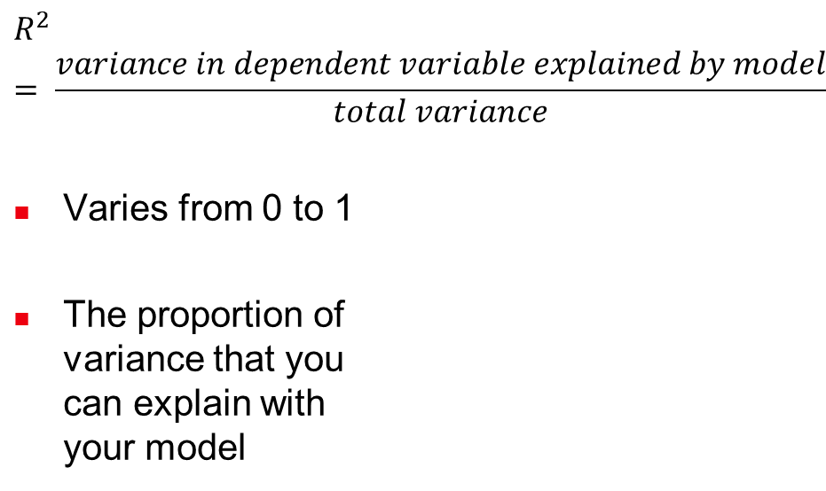
Model fit: R²
$$R^{2}= \frac{variance in dependent variable explained by model}{total variance}$$
Varies from 0 to 1
The proportion of variance that you can explain with your model
R² =0.62
The variation we can explain: 62%
All the variation that
exists in YouTube views (some have many views, some very little)

Slide 16
Model fit: RMSE
Root Mean Squared Error
Take the mean of all the squared errors/residuals (all the ‘sticks’)
Then take the root (√) of that
≈ “How much is your prediction typically off”
e ≈ 10,000M

Slide 17
Exercise 2: model evaluation
Continue in your Notebook. We are going to evaluate the fit of the model, with:
X: surface area in m²
Y: price in euros
Calculate the residuals (e) and add them to the dataframe
Make the following plots:
A scatter plot of (Y, Y’) (Y’ means predicted Y)
A scatter plot of (X, e)
What is the R² of the model?
What is the root mean squared error (RMSE)?
What is your conclusion about the fit? Which houses are predicted better? Cheap or expensive house?

Slide 18
Topics
Simple linear regression
Evaluation
Overfitting and model validation
Multiple linear regression

Slide 19
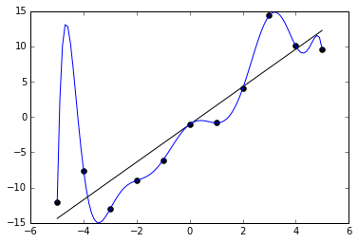
Overfitting
Even though the curved line fits the sample data well, it’s probably a poor model for the population! The line fits the population much better.

Slide 20
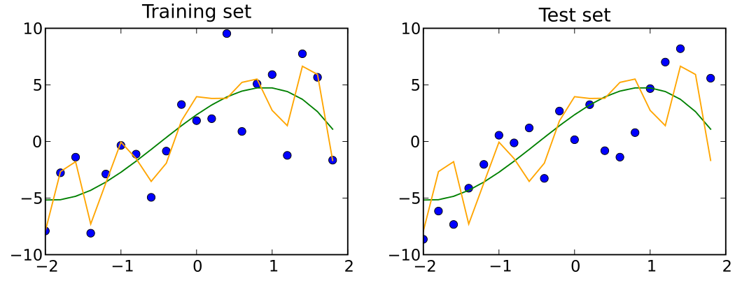
Training and test set
Two models trained on the training data set
Simple model in green
Complex model in orange
The test set is used only to test the data (not to calculate the coefficients / train the model).
The orange model overfits: it fits the training set ‘too well’

Slide 21
Training and test set
Usually in machine learning, we split the data at the beginning into a training (70-80%) and test set (20-30%)
We train the model on the training set
Then, using the model coefficients from the training set, we report performance on the test set
So, in linear regression, we take the line we found with the train data and plot the test data around it

Slide 22
Topics
Simple linear regression
Evaluation
Overfitting and model validation
Multiple linear regression

Slide 23

Equation
$$Y=b_{0}{+ b}_{1}X_{1}+{ b}_{2}X_{2}+…+e$$
For instance:
$$wage=2+0.3 ∙ age+0.2∙years_experience+…+e$$

Slide 24
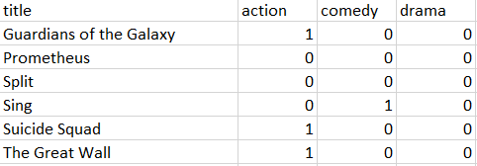
Categorical variables
Linear regression and other algorithms only accept numerical variables. So how can we use categorical variables?
By creating so-called ‘dummy variables’. Pandas can create them automically with pd.get_dummies()

Slide 25
Exercise 3
For reference, use the example Notebook multiple_linear_regression
Make a scatterplot matrix and a correlation matrix of the Funda data set
Based on this, choose 3 variables from the Funda data set as your independent variables (X) for the dependent variable price (Y). You want variables that have a linear relation and correlate well with price. Note: it does not work very well to select variables that are highly correlated with each other, such as rooms and bedrooms.
Split the data into a test set and a train set
Evaluate model performance by calculating R² and RMSE on the test set
Make a plot of the predicted price vs. the actual price. Which prices are predicted well?
Print out the coefficients and write the result in plain English.

